Slide 1
Udacity Connect Session
Welcome to the ALX-T Data Analysis Nanodegree
Project 3, Communicate Data Findings, Q & A
- Week 12, 2022

Slide 2

Agenda
Project 3 Check ups
Project 3 Overview
Q & A
Common Mistakes
Project Rubric
Dataset Reviews**

Slide 3

Exploratory data visualization
Exploratory data visualization generally occurs during and after the data wrangling process and is the main method that you will use to understand the patterns and relationships present in your data.
This understanding will help you approach any statistical analyses and will help you build conclusions and findings.
This process might also illuminate additional data cleaning tasks to be performed.

Slide 4

Explanatory data visualization
Explanatory data visualization techniques are used after generating your findings and are used to help communicate your results to others
You will be able to
Understand design considerations
Be a good producer and consumer of visualizations
Required
You will produce a short presentation that illustrates interesting properties, trends, and relationships that you discovered in your selected dataset.
The primary method of conveying your findings will be through transforming your exploratory visualizations from the first part into polished, explanatory visualizations.

Slide 5

At the end of the Project, you will be able to…
Supplement statistics with data visualizations data
Choose appropriate plots, limits, transformations, and aesthetics to explore a dataset
Use design principles to create effective visualizations to communicate findings to an audience
You may develop your project either locally or in the classroom workspace.
Submit from the workspace.
Submit a zip file on the last page of this project lesson

Slide 6
General Information
Conduct an Exploratory Data Analysis on a dataset of your choice
Go from Univariate, to Bivariate and then to Multivariate
Choose a perspective to take based on your dataset of choice
It does not need to be clean or perfect
It is your opportunity to ask questions about the data and make your discoveries.
Document your work carefully
There is no single answer that needs to come out of a given dataset
That sometimes exploration can lead to dead ends and may require multiple steps

Slide 7

Select your Dataset

Slide 8

Ford GoBike System Data
The data consists of information regarding 183,000 rides made in a bike-sharing system covering the greater San Francisco Bay area. The data features include duration (secs) and others such as DateTime, customer type, gender, and some additional variables.

Slide 9

Flights - Data Expo 2009 - Airline on-time performance
The data consists of flight arrival and departure details for all commercial flights within the USA, from October 1987 to April 2008
This is a large dataset: there are nearly 120 million records in total, and takes up 1.6 gigabytes of space compressed and 12 gigabytes when uncompressed.
You are also welcome to work with interesting subsets: you might want to compare
flight patterns before and after 9/11, or between the pair of cities that you fly between most often,
or all flights to and from a major airport like Chicago (ORD).

Slide 10

Loan Data from Prosper
This data set contains 113,937 loans with 81 variables on each loan, including loan amount, borrower rate (or interest rate), current loan status, borrower income, and many others.

Slide 11
PISA Data
PISA is a survey of students' skills and knowledge as they approach the end of compulsory education. This survey examines
how well students have learned the school curriculum,
how well prepared they are for life beyond school.
Around 510,000 students in 65 economies took part in the PISA 2012 assessment of reading, mathematics and science. Of those economies, 44 took part in an assessment of creative problem solving and 18 in an assessment of financial literacy.

Slide 12

You may also select your own dataset

Slide 13
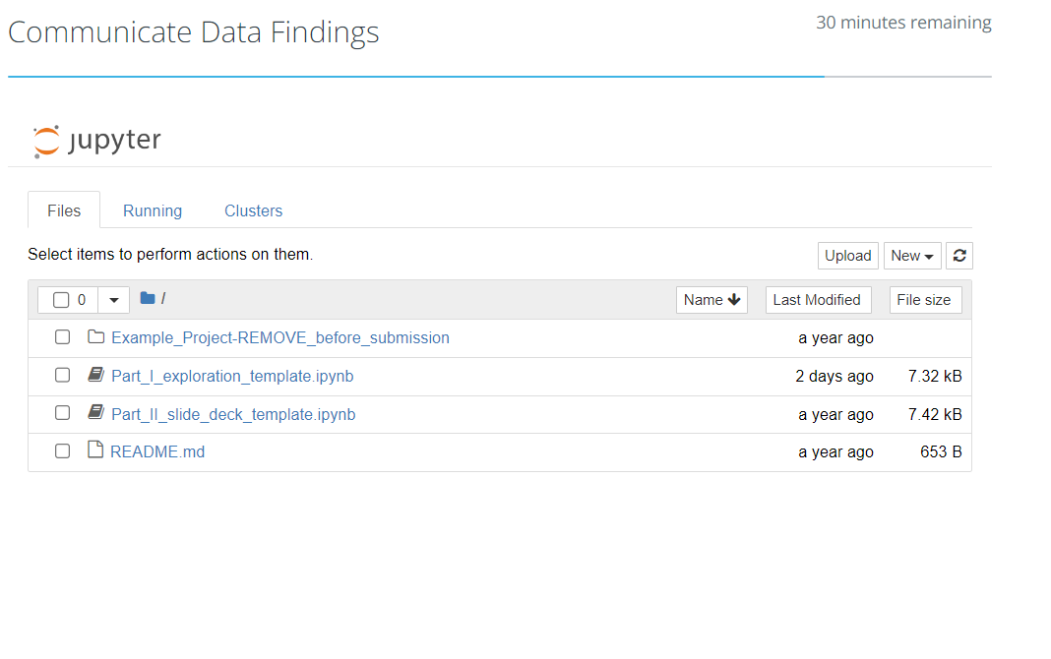
Download Starter Files
Project Template (udacity-data.com)
Project Template - It contains the starter files.
Review the Example Project Submission – Case Study
Example Project serve as an example of what a final project submission could look like.
This example project was built using the project template files and the diamond price dataset incorporated with this project.

Slide 14
Project Approach
Update these sections in the README.md file:
Introduce your dataset and document its source.
Summarise the steps you took in your data exploration.
Summarise your data exploration findings
Mention whether you plan to bring them into your explanatory presentation or not.
Key Insights for Presentation - Write about why/how you chose certain findings over others to put in your explanatory analysis.

Slide 15
Tip
Apply
Question-Visualization-Observations
… framework repeatedly to explore as many relationships as you want.
Be curious. Ask questions. One question can lead to more questions.
Keep exploring the data till you find the story you want to focus on. And keep narrating what’s going on in your head.
Conclusions
At the end of the notebook, you will record your conclusions which should be a summary of the main findings and reflect on the steps taken during the data exploration.

Slide 16
Explanatory Visuals: Tell a story about the data you explored
Use the Part_II_slide_deck_template.ipynb template notebook
Add a summary of key insights at the start of the notebook, just as you added in the README.md.
Use code that you used in your exploration phase to generate selective and polished plots.
Make sure that you pay attention to aspects of design integrity in your revisions.
You need to provide at least 3 visualizations to convey key insights, along with descriptive comments which accurately depict their purpose.

Slide 17
Get Feedback
Though not required, you may want to get feedback from at least one person before submitting your project.
By sharing your work with others, you can get input from a different perspective that catches things you may have missed initially.

Slide 18
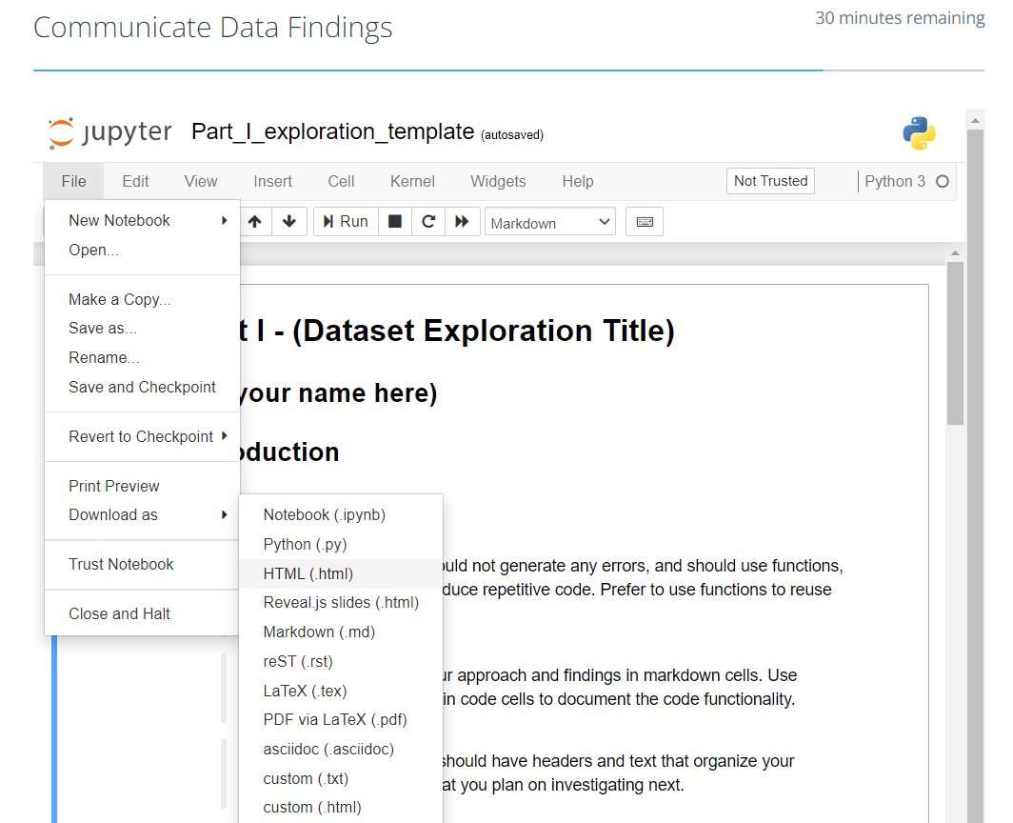
HTML or PDF File copy
After completion, make sure that you export the notebook as an HTML file for the project submission.
To do so, from the File > Download as... > HTML or PDF menu option.

Slide 19
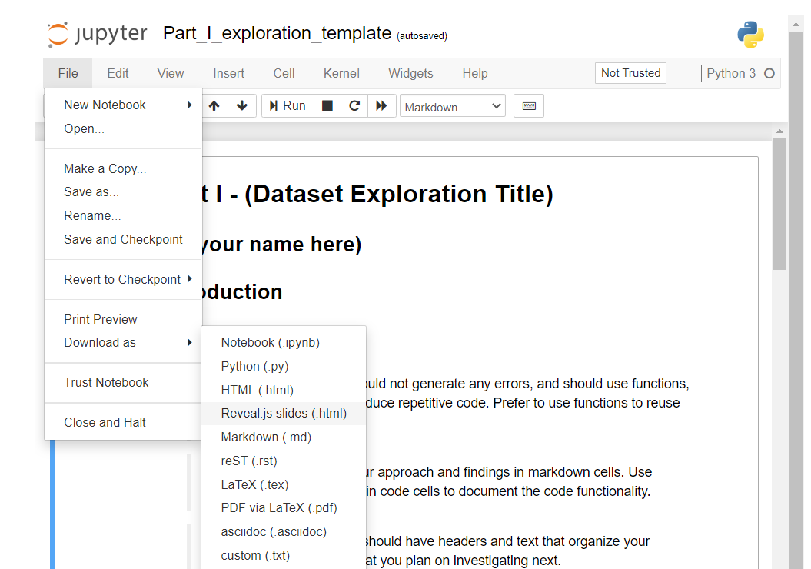
Create Slide Deck
Add Cell Toolbar - Add a specific Cell Toolbar to each cell in your notebook. To do this, select a cell and click on View > Cell Toolbar > Slideshow.
Choose Slide Type
Convert - Once you're ready to generate your presentation, use nbconvert to export the notebook and set up a server for the slides.

Slide 20
Project Submission
The size of your zipped file should be less than 500MB
Check size of Zip file

Slide 21
Q& A? Break Time

Slide 22

Common Mistakes
Not matching appropriate plot types with underlying data
Not formatting the plots with appropriate titles, labels, legends,
Not using the Question-Visualization-Observations framework to narrate the exploration to the reader.
Students do not generate at least 15 visualizations in the exploration phase, and at least 3 visualizations in the final presentation to convey key insights.
Students do not annotate their plots properly.
Students do not include a summary of the main findings from your Exploration, steps taken in exploration and key insights for the presentation in the README.md.
Students do not use all different types of plots (univariate, bivariate and multivariate) in your project to explore many relationships in the dataset.
Students add all plots from the exploratory analysis to their slide show.
Students do not generate a slide show (HTML) from the notebook.

Slide 23
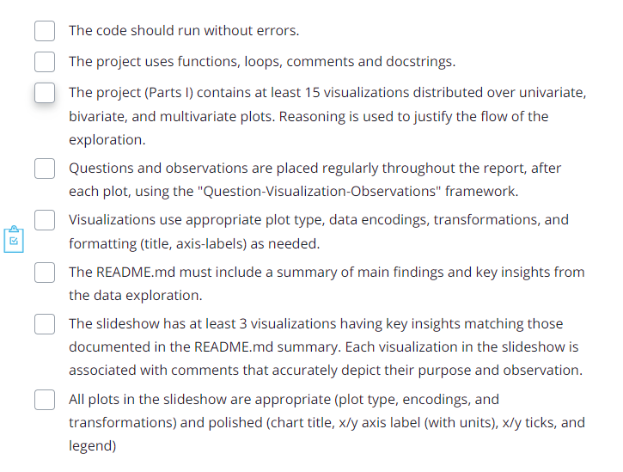
Checklist

Slide 24
Project Rubric
Udacity Rubric

Slide 25
Quick view …Loan Data from Prosper
This data set contains 113,937 loans with 81 variables on each loan, including loan amount, borrower rate (or interest rate), current loan status, borrower income, and many others.

